Slide 1
Connect Four
gene and meriselle !!

Slide 2
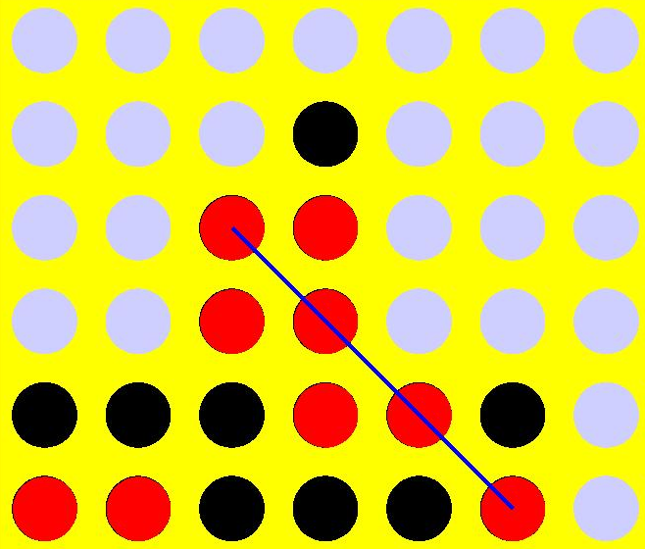
how to play
a game between two players with a board of 7 slots
each player has their own color of pieces (usually red vs black)
each takes turns inserting one of their pieces into the board of slots
if a player gets 4 pieces in a row (vertical, diagonal, horizontal) then they win

Slide 3
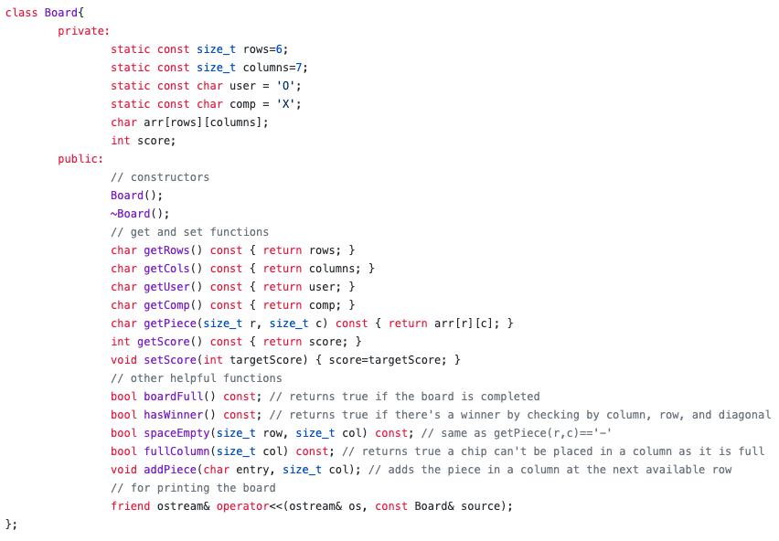
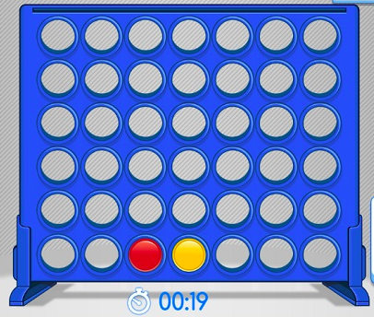
Board class
Simulates a board and board pieces
2D 7 x 6 array of char
Important functions:
hasWinner
boardFull
fullColumn
addPiece
ostream is for printing out the board
MiniMax algorithm uses board score to determine cost

Slide 4
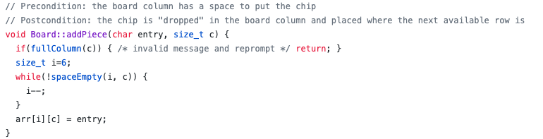
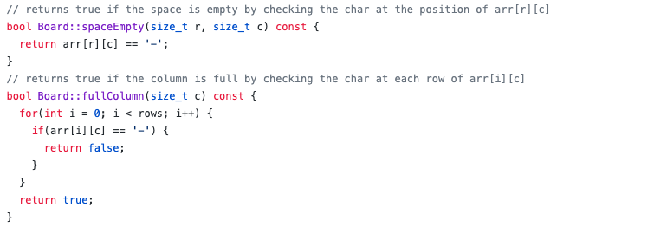
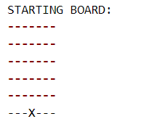
how it works: addPiece

Slide 5
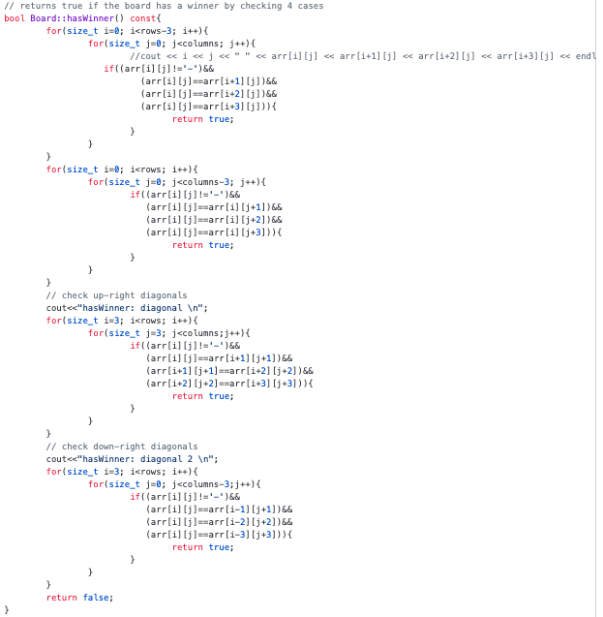
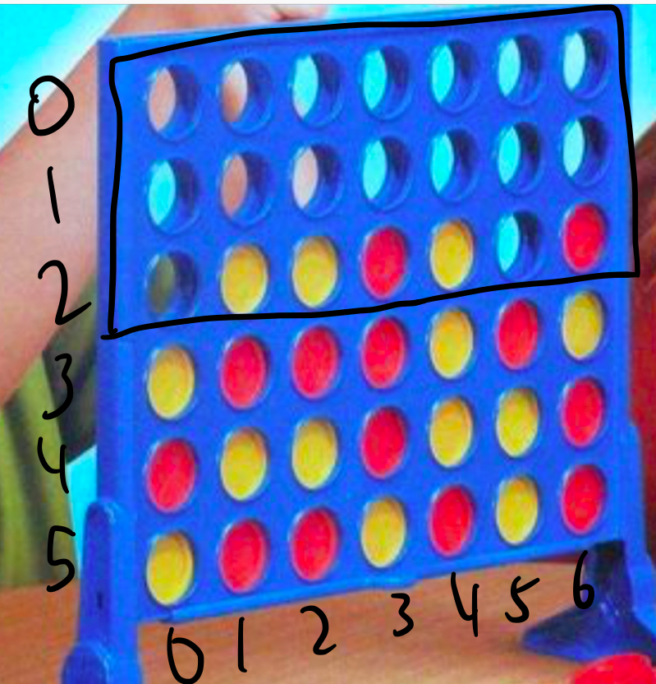
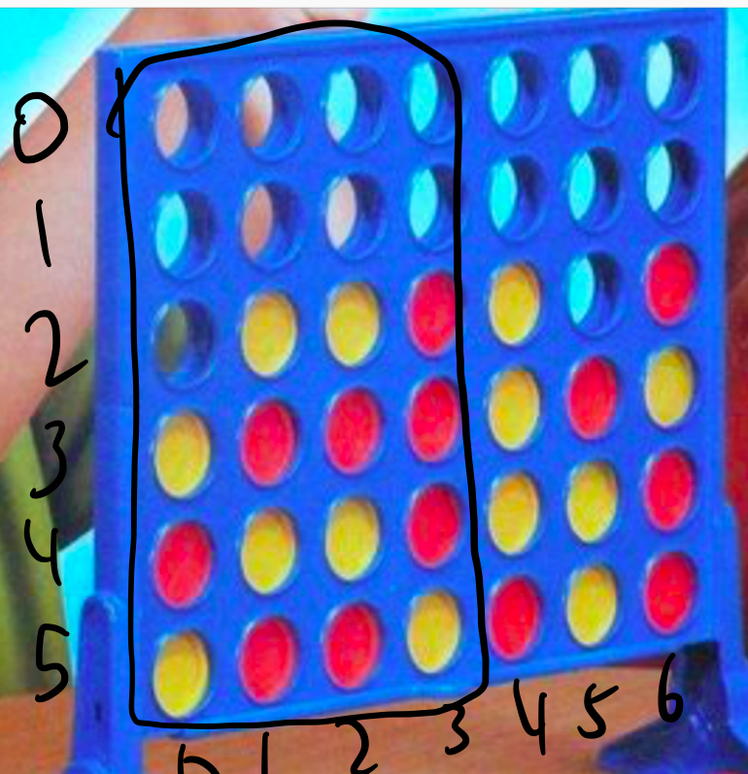
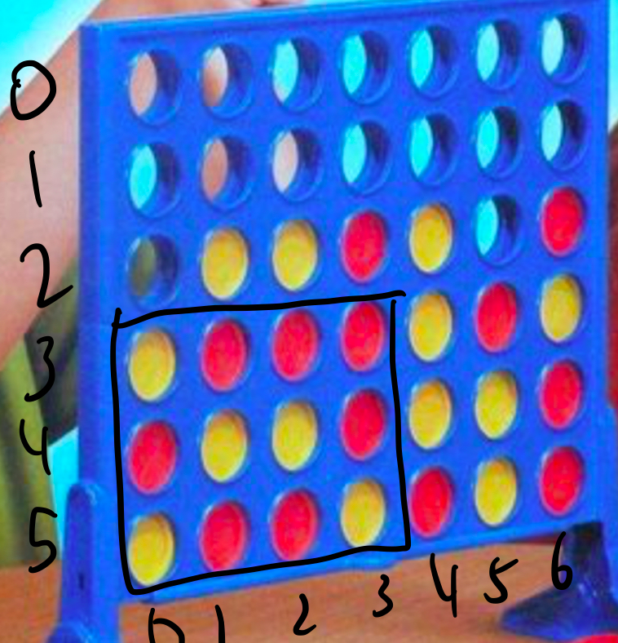
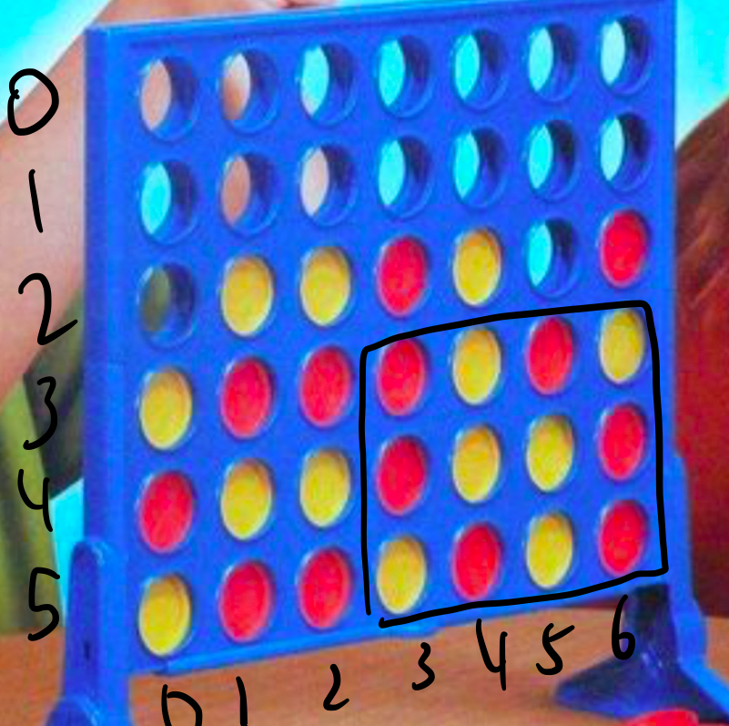
how it works: hasWinner

Slide 6
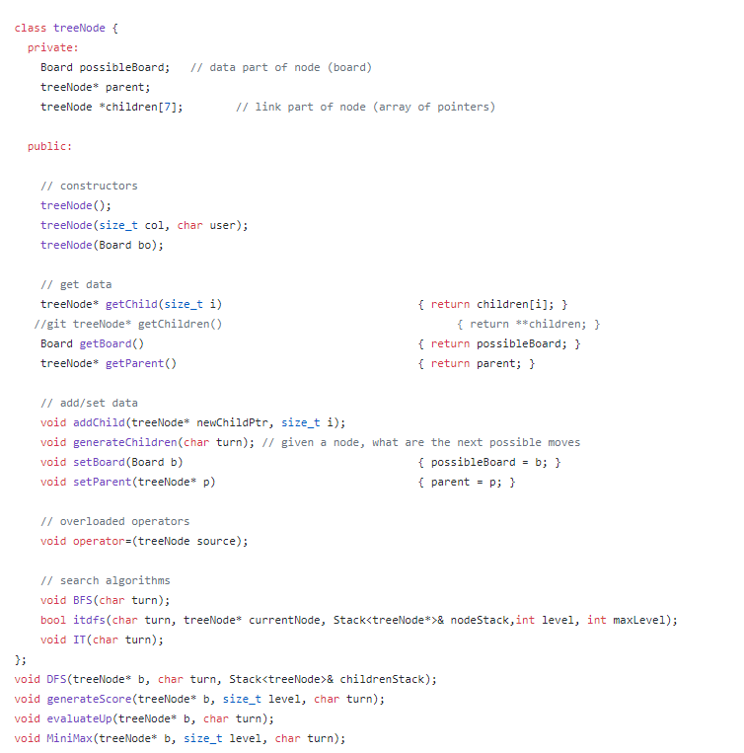
treeNode Class
data: Board
link: array of pointers[7] that point the node to all its children
two important functions:
addChild
generateChildren
also an important variable:
parent pointer

Slide 7
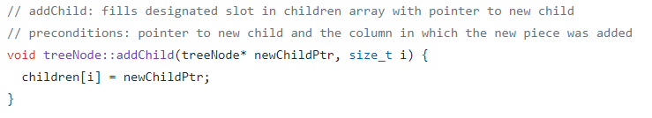
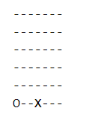
how it works: addChild

Slide 8
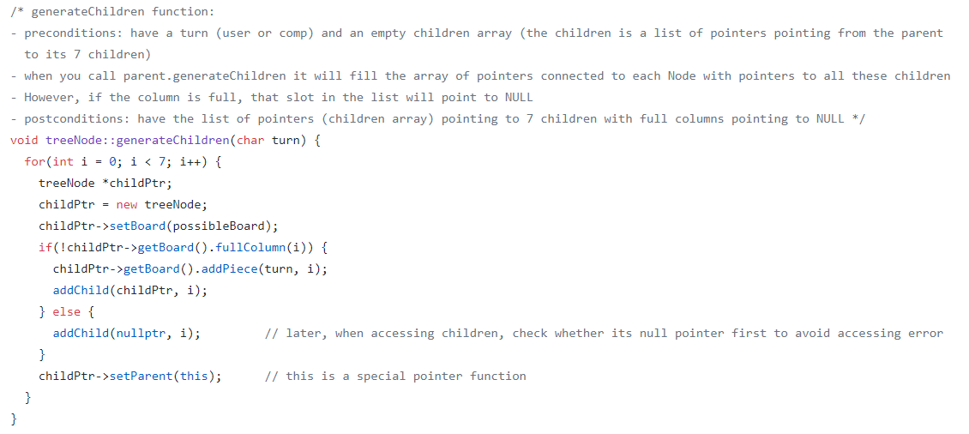
how it works: generateChildren(char turn)

Slide 9
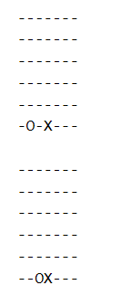
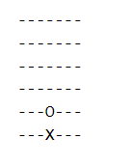
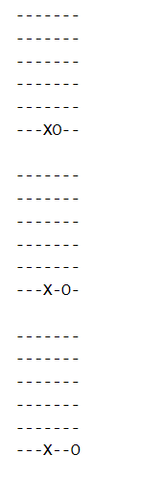
generateChildren

Slide 10
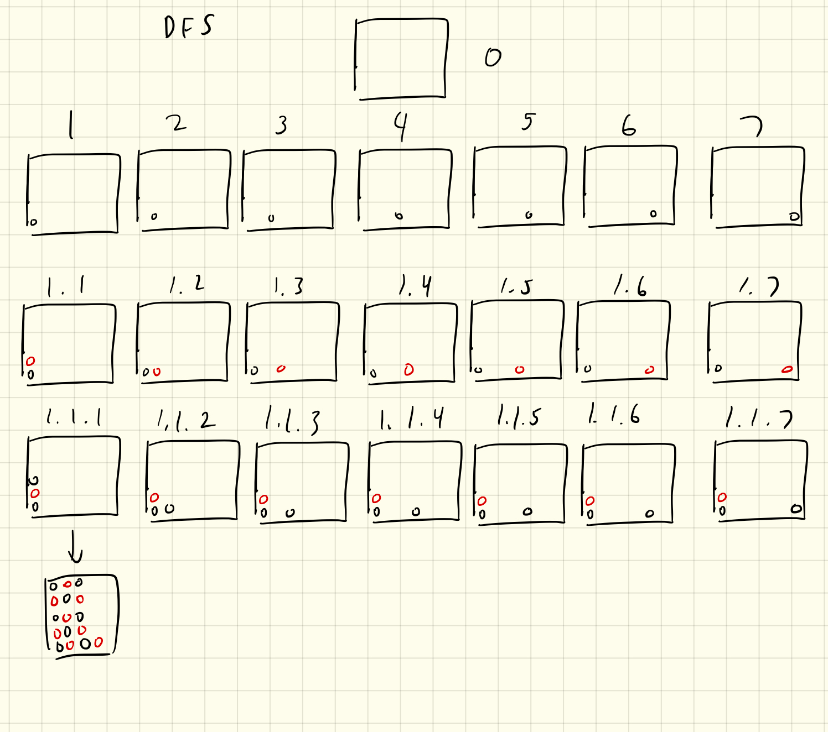
depth first search
Recursive
Base Case: Stops when there’s a winner or if there’s a tie and there’s no more children to check -> print parent
Keeps track of children using a stack for backtracking

Slide 11
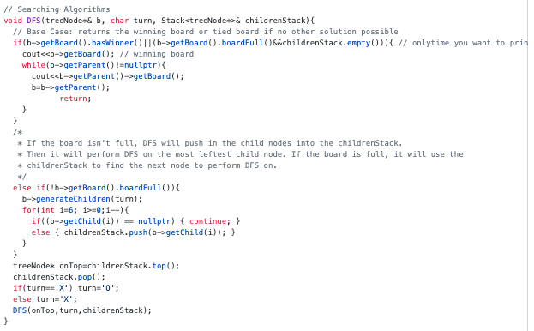
depth first search
If the board isn’t full, it generates children, pushes them into a stack, takes the first child, and continues the DFS until it reaches the base case.
If the board is full, it performs DFS on the next available board in the stack

Slide 12
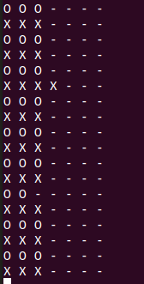
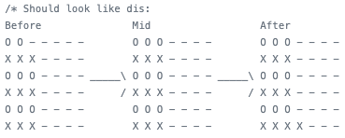
DFS Demo
Expected output
It matches! It just prints the opposite way
Actual output

Slide 13
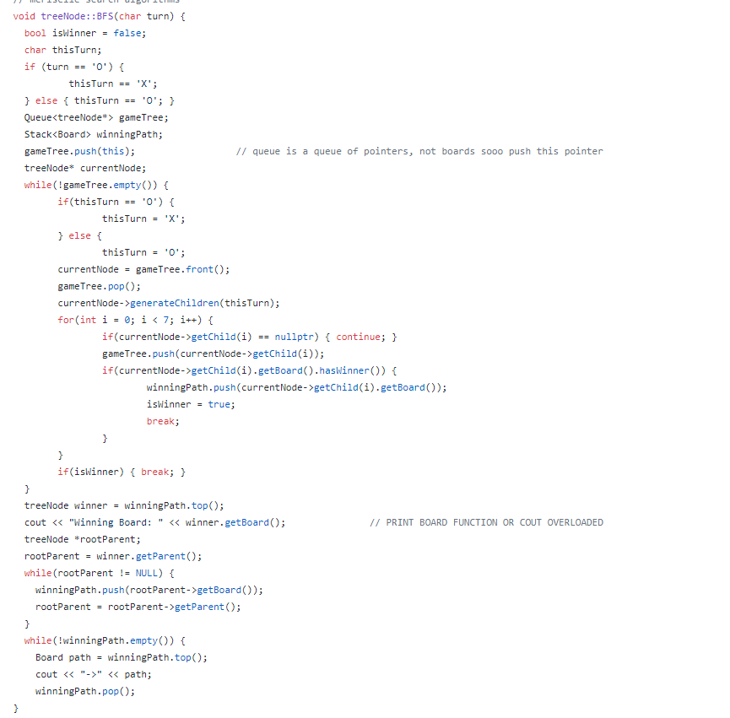
breadth-first search
uses a Queue<treeNode*>
because we use an array of pointers to the children
the while loop
Stack<winningPath>

Slide 14
bfs code analysis:
initial part of the bfs code
and the while loop

Slide 15
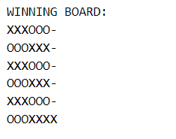
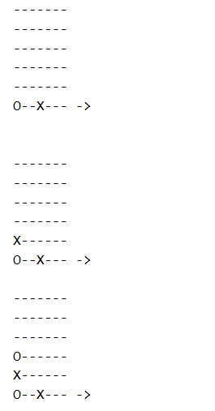
bfs code analysis: printing the path

Slide 16
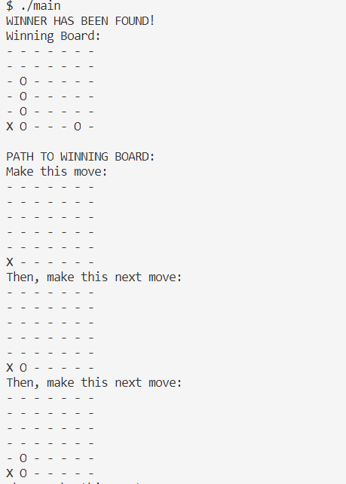
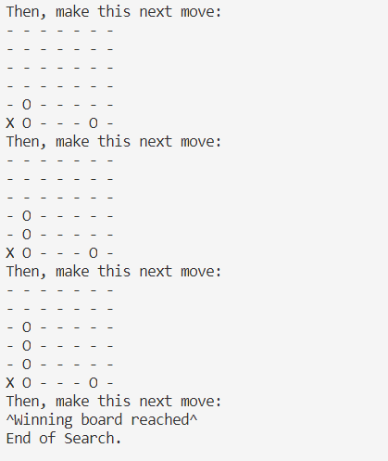
bfs demo

Slide 17
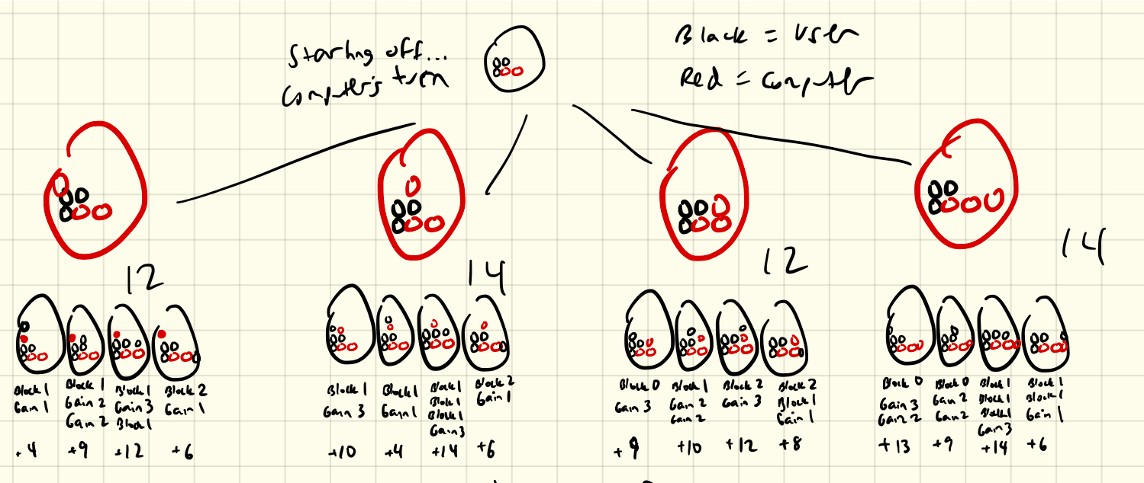
minimax
Assumes that the player you’re versing against always has the optimal solution
AI/computer tries to maximize its score while minimizing the player’s score
Tree does a BFS with a depth of a certain level (the more levels, the more in-depth the algorithm). At the lowest level, the leaves generate scores. These scores are evaluated upwards depending on whether the level is trying to minimize or maximize.

Slide 18
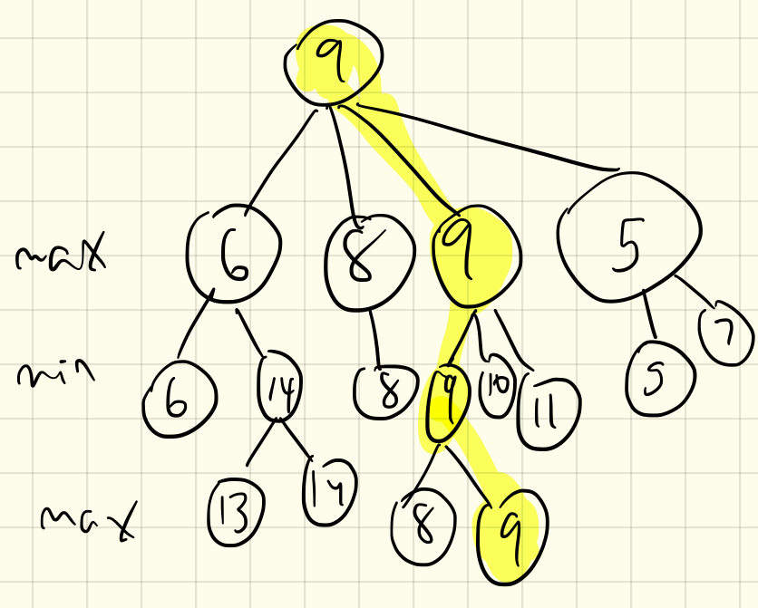
minimax
Things to consider:
NULL children
How to score a connectFour board?
Two parts: going down the tree and then evaluating upward
void MiniMax(const treeNode* b, size_t level, char turn);
void generateScore(treeNode* b, size_t level, char turn);
void evaluateUp(treeNode* b, char turn);
* Precondition: A root containing board b that can still be filled
* Postcondition: A tree from that board b with 4 levels of possible board choices. Each node has 7 children. When the program finishes, each leaf score is calculated with generateScore. At the end, evaluateUp takes each leaf score and "miniMaxes" it upward.

Slide 19
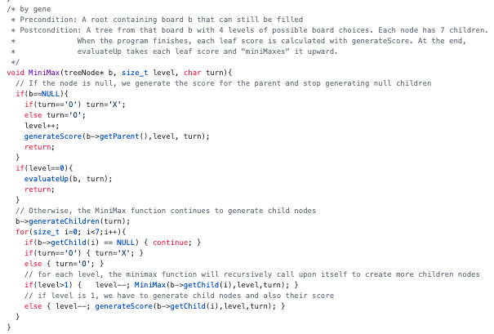
how it works: MiniMax
Base Case: If the node reaches NULL, we generate the score of the parent
Second Base Case: Once the level reaches 0 (we set maxLevel to 4), it evaluates upward
Otherwise, it will continue to generate children. At level 1, we generate the scores of the children and then level==0, allowing us to evaluate up

Slide 20
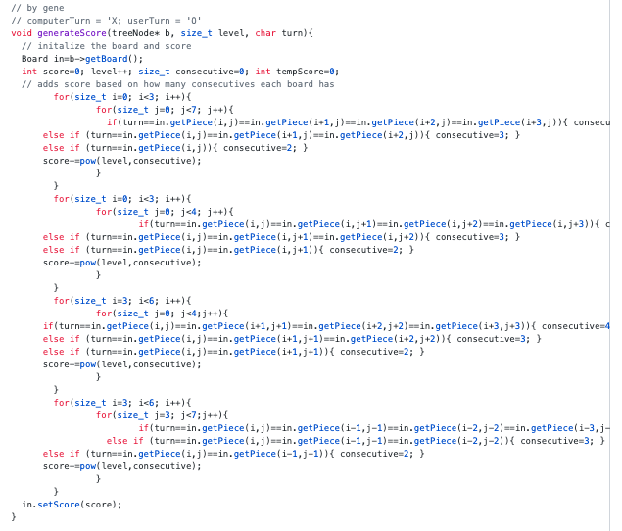
how it works: generateScore
Takes the hypothetical board and for every consecutive piece, adds the score based on level^numConsecutive.
This is so that the higher the level, the closer you are to winning
This doesn’t take into consideration blocking moves, however

Slide 21
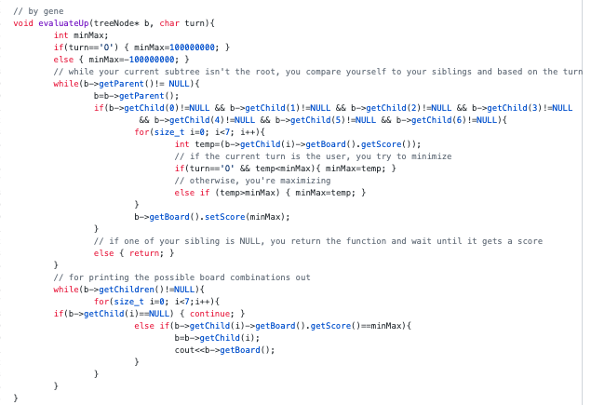
how it works: evaluateUp
Going up:
Compares siblings and depending on the turn, either minimizes or maximizes
If any of the siblings are NULL, we stop the function as some siblings don’t have a score yet probably (this is probably wrong)
Going down:
For printing the path purposes

Slide 22
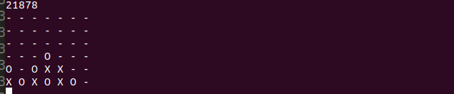
Minimax Demo
getScore function works and it returns the board at level 0. However, evaluate Score is not called.

Slide 23
comparing minimax to bfs and dfs
MiniMax definitely takes a lot more memory and more time, but it is more accurate. The more levels you visit, the more accurate your moves.
You can make MiniMax more efficient using alpha-beta pruning
BFS and DFS is a tossup: it really depends on your starting board.
You can give your algorithm something like:
X -- X O O
O -- O X X
X -- X O O
O -- O X X and it’ll be really hard to adapt to the different configurations of the board bc DFS and BFS are brute force methods.
DFS will continue playing until the board is full or someone wins.
BFS takes up a bunch of memory, creating a bunch of children

Slide 24
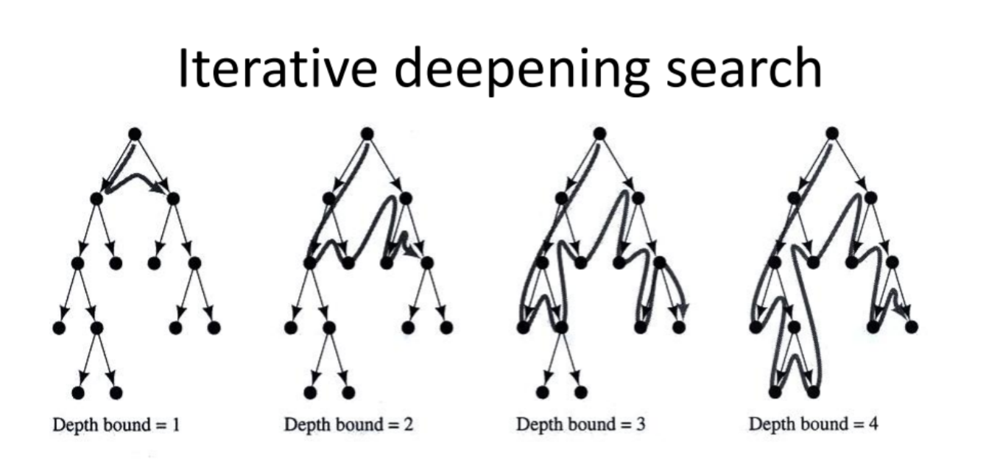
iterative deepening: what is it

Slide 25
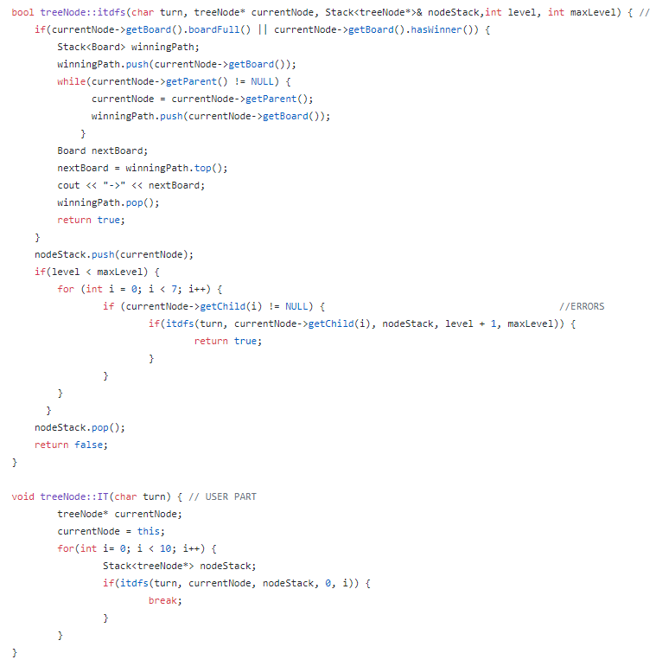
iterative deepening: our code
basically
dfs performed
multiple times
increasing
level depth
each time

Slide 26
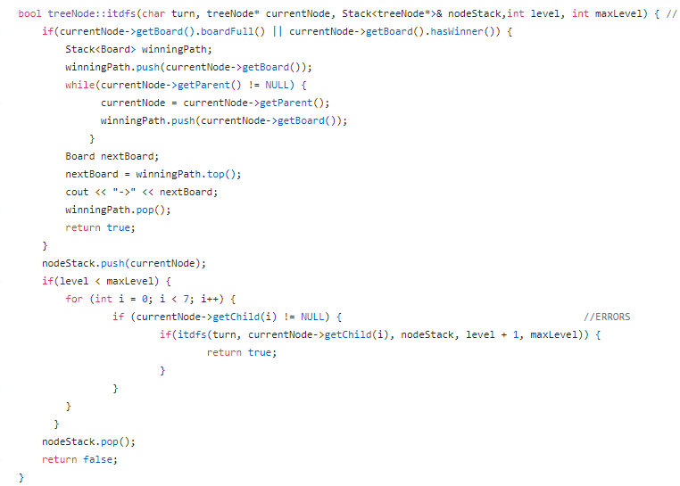
a closer look: the modified dfs for iterative deepening
prime differences:
initial level
max level

Slide 27
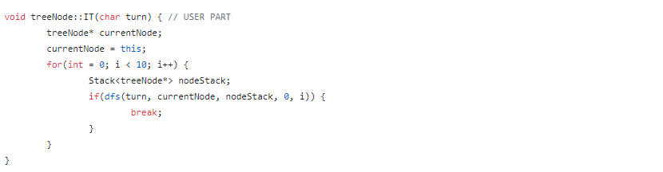
the actual iterative deepening part
loops through and calls dfs for a number of levels (10)
starts at level 0 and increases its “depth” level each loop back
until max loop (10) is reached

Slide 28
comparing iterative deepening to bfs and dfs
a combination of the two:
wide range and complete search similar to BFS
but space efficiency similar to DFS
so more memory efficient than bfs and more of a complete search than dfs
a disadvantage is that certain nodes will be visited multiple times

Slide 29
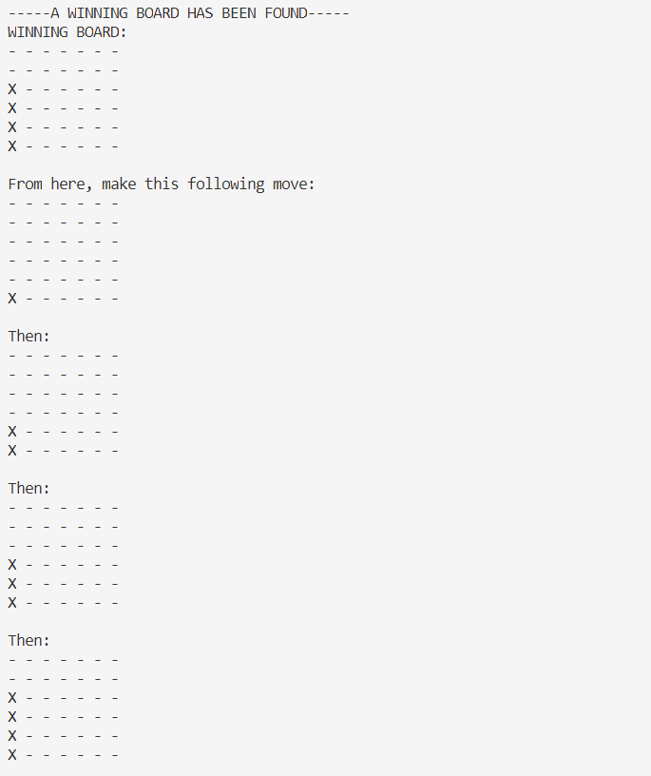
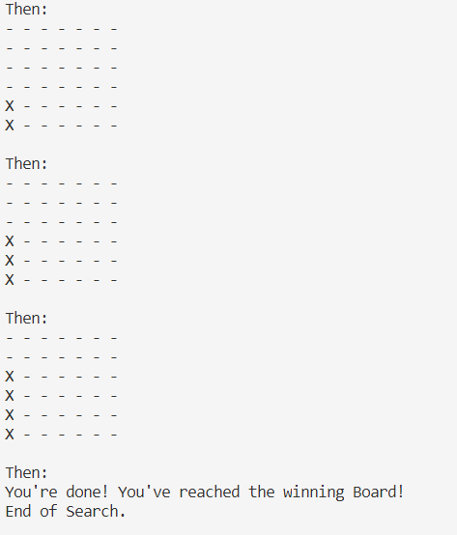
demo of iterative deepening:

